Slide 1
Fall DemoSat
Preliminary Design Review
Arian Rasoli
09.17.2025

Slide 2
Mission Overview
Design a robust atmospheric payload capable of detecting and measuring key atmospheric layers.
Feed measurements into a pre-trained tiny machine learning model trained on historical atmospheric data to classify the corresponding atmospheric layer
Model predicts atmospheric layers from 0 through 5 for real-time classification.
Ensure reliable payload functionality and proper error handling throughout the flight.
After flight, the use of Python will help us understand the data of real atmospheric layer measurements versus the model’s predicted classifications.
Create a tiny machine learning model that can be reutilized for future use cases in DemoSat.

Slide 3
Arduino Nano 33 BLE Sense Rev 2 – Hardware Overview
Processor: ARM Cortex-M4 @ 64 MHz (32-bit, low-power)
Memory: 256 KB Flash, 128 KB RAM
  Suitable for TinyML
Onboard Sensors (not used in this project)
  Temp, humidity, barometric
  IMU
  Microphone
Fully compatible with TensorFlow Lite for microcontrollers
Capable of performing real-time data classification on sensor inputs.
Advantages
  Low power consumption
  Lightweight and suitable for embedded flight system
  Enables an efficient deployment of TinyML models

Slide 4
Mission Requirements
Cost must be below $500
Temperature must withstand temperature down to -40 ºC
Payload weight must be below 800g
Pressure resistant at high altitudes
Battery must be able to withstand severe conditions
Post-Flight code data analysis
Develop documentation and code for future projects that might be done
Have a functioning/reliable TinyML model for layer classification

Slide 5
Subsystem Requirements
Power
  Our power supply (9V Battery), must be able to withstand extreme conditions while being able to supply our systems
  We will need to power our: Switch, Arduino Nano 33 BLE Sense Rev2, and BME280, AS7331 sensors.

Slide 6
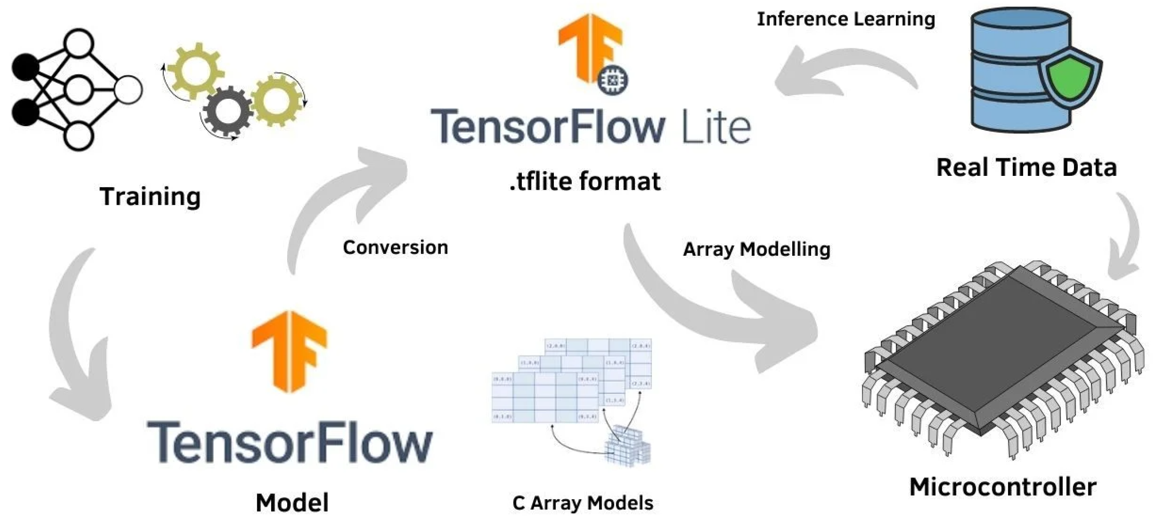
TensorFlow Machine Learning Architecture

Slide 7
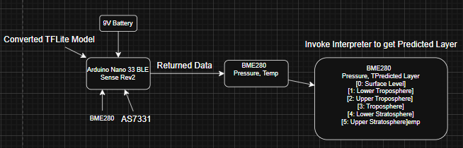
Rough Sketch Diagram
Will have better Diagram by CDR

Slide 8
Commands and Sensors
When Switch == ON
  Data collection starts
    BME280, AS7331
      Feed this data: temperature and pressure to model.
    From each data collected, saved onto an SD card.
      I only intend to use one 8gb SD Card for this expirement
When Switch == OFF
  Data collection is NULL

Slide 9
Testing Plans
Battery Capability
  Environmental testing, Pressure testing
Sensors
  Drop test, Functionality, Environmental
LEDs/Switch Functions
  Whip, Drop, Functionality

Slide 10
Parts List
9V battery
Sensors
  OpenLog (SD card reader)
  BME280 (Pressure & Temp sensor)
  VEML6075 (UV-A and UV-B Sensor)
Microcontrollers
  Arduino Nano 33 BLE Sense Rev2
Box : Unsure about dimensions (don’t think it’ll be more than 4x4)

Slide 11
Expected Results
The model is expected to accurately identify the atmospheric layer the payload is currently in based on sensor readings.
It will provide layer transitions (Surface, Troposphere, Stratosphere) as the payload ascends.
Based on the current accuracy of the model, I predict the model will successfully classify atmospheric layers >90% of the time under flight conditions.

Slide 12
Structure
Arian Rasoli - Team Lead, Embedded Systems Engineer.
Current Schedule
  PDR: 9.17.2025
  CDR: ?
  FRR: ?
  Launch: 11.4.2025 ?
  Final Report Due: ?

Slide 13
Conclusion
I expect to have a viable system that will collect basic atmospheric weather conditions and pass it into a model for atmospheric layer classification.
I plan to optimize my weight and have the necessary systems to keep it up and running.
I plan to analyze the data post-flight to see the accuracy of the model
I am confident that the model will work as intended and accuracy to be about 90% during flight.

Slide 14
Acknowledgements
Professor Jones
Professor Wikowsky
Professor VandenPlas
Colorado Space Grant Consortium

